Slide 1
Interview Questions

Slide 2
What is Kotlin?
Kotlin is statically typed and runs on the Java Virtual Machine (JVM).
The Kotlin language is designed to be interoperable with Java, so you can use Kotlin code alongside Java code seamlessly.
Aside from Android app development, it is also used for server-side and web development.

Slide 3
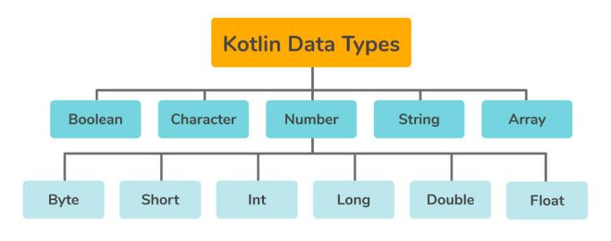
What are the various data types available in Kotlin?

Slide 4
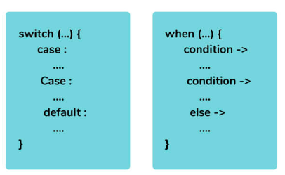
Explain about the “when” keyword in the context of Kotlin.

Slide 5
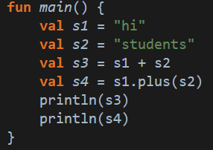
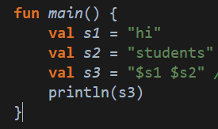
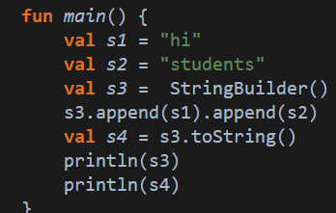
How can you concatenate two strings in Kotlin?

Slide 6
Explain the various methods to iterate over any data structure in Kotlin with examples.
For Loop
While Loop
Do While Loop
Which of the following file extensions denotes a Kotlin file?
.kt or .kts

Slide 7
How are variables declared in Kotlin? What are the different types of variables in Kotlin?
Immutable Variables
Mutable Variables
If you want to declare some mutable (changeable) variable, you should use var.
If you want to declare the immutable variable, you should use val because val variables can't be changed once you have assigned them.

Slide 8
What is Kotlin?
A new version of Java.
b) A JavaScript framework.
c) A statically-typed programming language for the JVM, Android, and browser.
d) A database management system.
Answer:
c) A statically-typed programming language for the JVM, Android, and browser.

Slide 9
Which platform does Kotlin primarily target?
Python Bytecode
b) JavaScript
c) JVM (Java Virtual Machine) Bytecode
d) PHP
Answer:
c) JVM (Java Virtual Machine) Bytecode

Slide 10
How do you declare a variable in Kotlin?
a) let myVariable = 10;
b) val myVariable: Int = 10
c) const myVariable = 10;
d) var myVariable: Int = 10

